Slide 1
Santander Customer Transaction Prediction

Slide 2
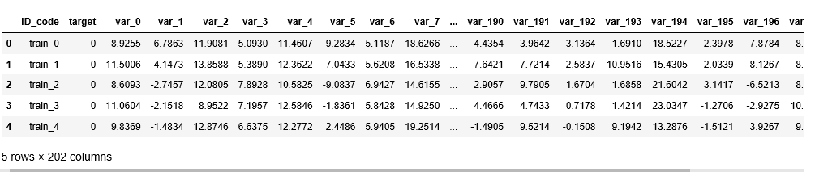
Data pre-processing
High level view of the data

Slide 3

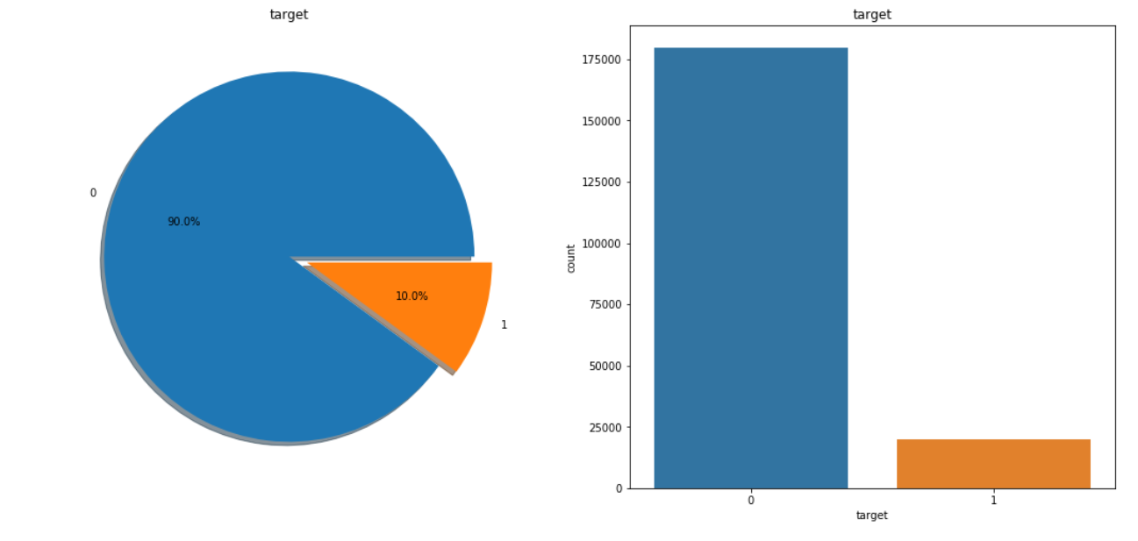
Checking for null or missing values in the dataset
Check the distribution for target variable in the dataset

Slide 4
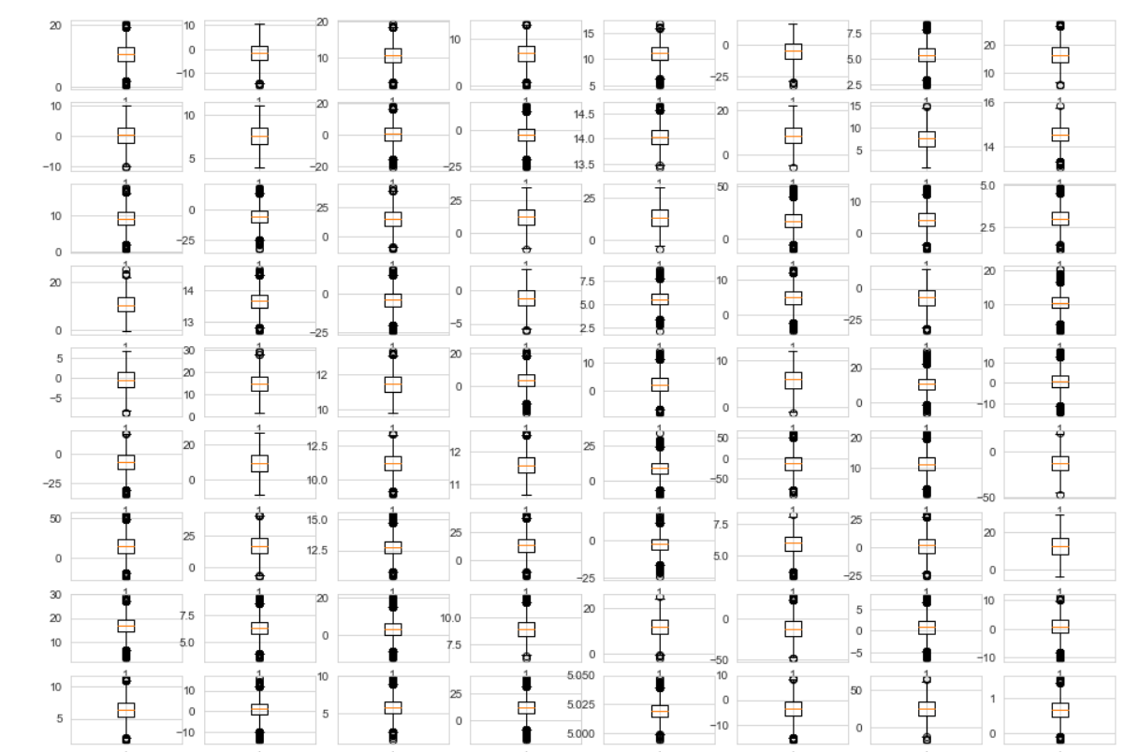
Box plot for all the variables
The box plots show that almost all features are normal and do not show any sort of skewness among them.
Also, we cannot find any abnormal outliers in any of the feature.

Slide 5
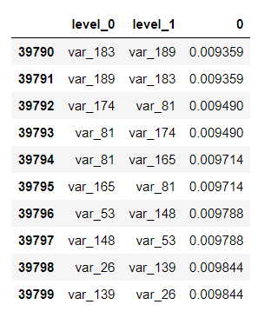
Finding Pearson correlation between all the features
(Top 10 most correlated features)
Results show that none of the features show strong linear correlation with other features or the target variable.

Slide 6
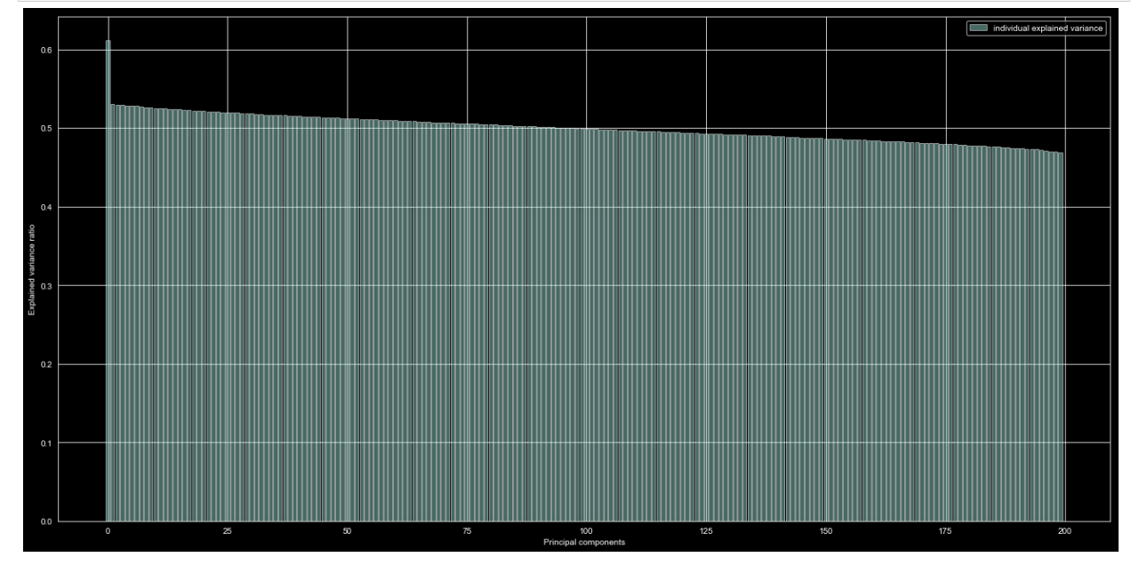
Principal component analysis

Slide 7
All the features in this particular dataset have numerical columns, with no skewness among them, also they have a lot of distinct values, suggesting they are somewhere continuous and hence any bucketing technique usually applied to discrete data is not applicable.
The features do not show person correlation with each other or the target variable directly.
Hence we perform a PCA to check for a possible chance of dimensionality reduction.
Results show that all of the features for this dataset are important
and hence we cannot reduce features with the help of PCA.
Therefore, any sort of feature engineering does not work here and we proceed with
Implementing the models directly on raw data.

Slide 8
Ml models
(i) Gradient Boosting Classifier
(ii)Adaptive Boosting Classifier
(iii)Neural Network
(iv)Logistic Regression
(v)Random Forest Classifier
(vi)K Nearest Neighbour

Slide 9
results
Model Name | ROC score with split = 0.3 | ROC score with split = 0.2 and ShuffleSplit
Logistic Regression | 0.77 | 0.80
Random Forest Classifier | 0.68 | 0.68
K Nearest Neighbour | -- | 0.44
Neural Network | 0.65 | 0.72
Adaptive Boosting Classifier | -- | 0.77
Gradient Boosting Classifier | -- | 0.89
Naïve Bayes | 0.68 | --
ROC score with split = 0.2
0.62
0.53
--
0.62
--
0.51
--

Slide 10
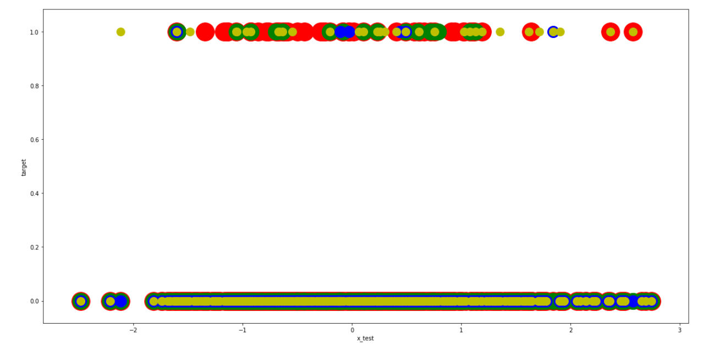
Predicted value of various models
(results for the 3rd column)
Logistic regression – green
Random forest – blue
Neural network – yellow
Actual value - red

Slide 11
Confusion matrix
Model Name | True Positive | True Negative | False Positive | False Negative | TP/FN
Gradient Boosting | 35967 | 139 | 19 | 3875 | 9.28
Logistic Regression | 35459 | 1097 | 527 | 2917 | 12.15
Random Forest | 35525 | 305 | 461 | 3709 | 9.57
Neural Network | 34459 | 1147 | 1527 | 2867 | 12
Naïve Bayes | 51620 | 524 | 2266 | 5590 | 9.2
LightGBM | 44514 | 379 | 461 | 4646 | 9.58

Slide 12
Gradient boosting seems like the best one among all but when applied to test data gives a low score of 0.66 on the leader board.
Since none of the models individually give us a very good result, we can consider some ensembling techniques to help increase the score of the system.
One more point to keep in mind is that the dataset is highly imbalanced and some corrective measures for that can also be taken to increase the score of the system.

Slide 13
Ensemble methods: Refers to sets of systems that combine to create a new system using the same learning technique. Bagging and Boosting are the most extended ones.
Hybrid methods: Takes a set of different learners and combines them using new learning techniques. Stacking (or Stacked Generalization) is one of the main hybrid multiclassifiers.
There are three methods of ensembling:
a. simple averaging
b. bagging
c. boosting

Slide 14
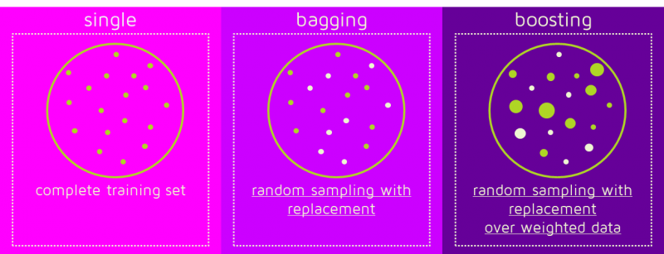
Bagging and boosting
In the case of Bagging, any element has the same probability to appear in a new data set. However, for Boosting the observations are weighted and therefore some of them will take part in the new sets more often:
These multiple sets are used to train the same learner algorithm and therefore different classifiers are produced.

Slide 15
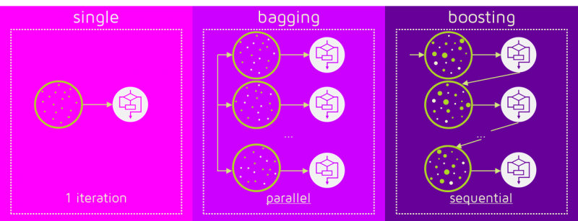
While the training stage is parallel for Bagging (i.e., each model is built independently), Boosting builds the new learner in a sequential way:
In Boosting algorithms each classifier is trained on data, taking into account the previous classifiers’ success.
After each training step, the weights are redistributed. Misclassified data increases its weights to emphasise the most difficult cases. In this way, subsequent learners will focus on them during their training.
Therefore, boosting works better than bagging in problems having imbalanced dataset.

Slide 16
Boosting again has three very popular methods:
(i) XGBoost
(ii) LightGBM
(iii)CatBoost
In this problem we will use LightGBM as a method to improve our model's score.
LightGBM is chosen over the two because it is much faster as compared to XGBoost and CatBoost is a good choice when we have categorical variables, since all the features are numerical, LightGBM is the best option.

Slide 17
Results of all the boosting algorithms
Model Name | ROC Score
LightGBM | 0.68
CatBoost | 0.60
XGBoost | 0.56
(without tuning the parameters)

Slide 18
Results after simple majority voting
Model Name | ROC Score
Naïve Bayes + Logistic Regression | 0.67
Naïve Bayes + Catboost | 0.67
Naïve Bayes +XGboost | 0.56
Naïve Bayes + LGB | 0.89
Naïve Bayes +NN | 0.61
Naïve Bayes + RF | 0.64
Logistic Regression + NN | 0.60
Naïve Bayes + LGB+RF | 0.89
Every model makes a prediction (votes) for each test instance and the final output prediction is the one that receives more than half of the votes.

Slide 19
Results after oversample
Model Name | Over Sample
LightGBM | 0.86
Logistic Regression | 0.77
XGBoost | 0.83
LightGBM | 0.9
Naïve Bayes | 0.80
Gradient Boosting | 0.80
CatBoost | 0.83

Slide 20
Results with lightgbm parameters tuned
'bagging_freq': 5, (frequency for bagging)
'bagging_fraction': 0.335, (randomly select part of data without resampling)
'boost_from_average':'false’, (adjusts initial score to the mean of labels for faster convergence)
'boost': 'gbdt’, (traditional Gradient Boosting Decision Tree)
'feature_fraction': 0.041, (LightGBM will randomly select part of features on each iteration)
'learning_rate': 0.0083, (determines the impact of each tree on the final outcome)
'max_depth': -1, (limit the max depth for tree model. This is used to deal with over-fitting)
'metric':'auc’, (metric(s) to be evaluated on the evaluation set(s))
'min_data_in_leaf': 80, (minimal number of data in one leaf)
'min_sum_hessian_in_leaf': 10.0, (minimal sum hessian in one leaf)
'num_leaves': 13, (max number of leaves in one tree)
'num_threads': 8, (number of threads for LightGBM)
'tree_learner': 'serial’, (single machine tree learner)
'objective': 'binary’, (binary log loss classification (or logistic regression). Requires labels in {0, 1}
'verbosity’: -1 (controls the level of LightGBM’s verbosity)
Final ROC score is : 0.900
StratifiedKFold applied along with 11 folds

Slide 21
Results with lightgbm and gridcv applied
All three boosting algorithms have an array of hyper-parameters and choosing the best combination of them to get the maximum is a big challenge. One way to cope with this is to use grid search.
Grid search is a method to perform hyper-parameter optimisation, that is, it is a method to find
the best combination of hyper-parameters (an example of an hyper-parameter is the learning rate of the optimiser),
for a given model (e.g. LightGBM) and test dataset. In this scenario, there are several models, each with a different
combination of hyper-parameters. Each of these combinations of parameters, which correspond to a single model,
can be said to lie on a point of a "grid". The goal is then to train each of these models and evaluate
them e.g. using cross-validation. Then select the one that performed best.

Slide 22
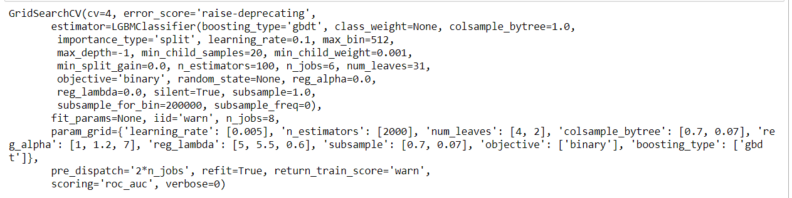
Final ROC score is : 0.900

Slide 23
Lightgbm with data augmentation
Final ROC score is : 0.901
By performing augmentation, the model can be prevented from learning irrelevant patterns, essentially boosting overall performance.
online augmentation, or augmentation on the fly, is preferred for larger datasets, as you can’t afford the explosive increase in size. Instead, transformations are performed on the mini-batches that are feed to the model.

Slide 24
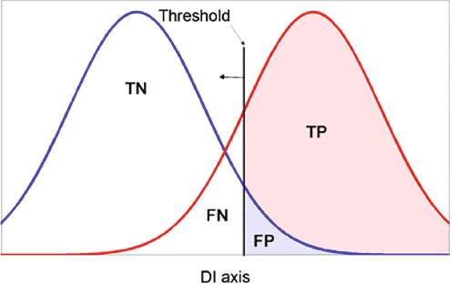
Further steps to improve the roc score
ROC is a probability curve and AUC represents degree or measure of separability. It tells how much model is capable of distinguishing between classes. Higher the AUC, better the model is at predicting 0s as 0s and 1s as 1s.

Slide 25
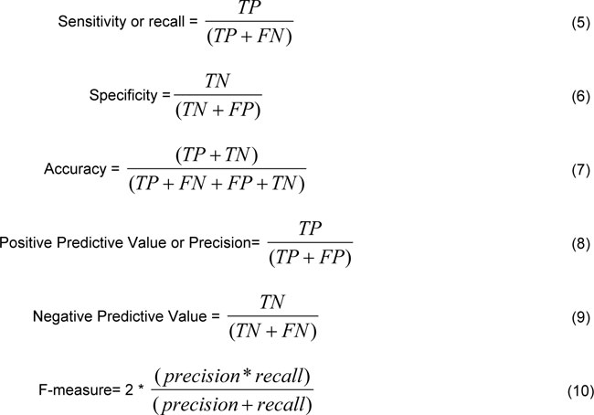
Tradeoff – decrease the threshold more positive value, this increases the sensitivity.

Slide 26
To adjust the decision threshold; in order to maximize the sensitivity:
Sampling
Anomaly Detection
To alter the prediction threshold value by doing probability calibration
Assigning weight to classes such that the minority class gets larger weight
Probability Calibration:
Platt Scaling
Isotonic Regression
Anomaly Detection:
Random Forest with distance based outlier partitioning with ensemble voting method

